Slide 1

Face Mask Detection and Social Distancing
Akram Mohammed
Shaik Misbah Bilal
Yeshas chikkannappa veerabhadra swamy
Naga Phanendra Vellapu

Slide 2
OVERVIEW
Research Question
Objectives
Literature Surveys
Implementation
Design Methodology
Process
Convolutional Neural Networks
Methods Used
Social Distancing
Model Evaluation
Results

Slide 3
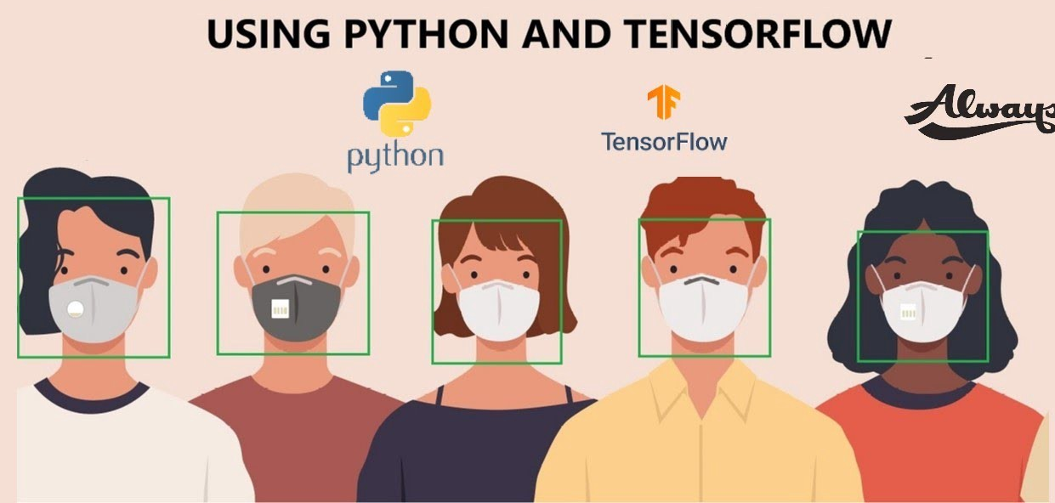
Research Question
Identifying the best method which can be helpful to upcoming generation to avoid the risk of getting affected by any kind of viruses
How can we use present technology and data which will help in rectifying the problem.
Using large amount of images available in the form of data as well as doing real time image processing to deal with the situation and finding the solution

Slide 4
OBJECTIVES
It is important to make people follow the rules where it has to be followed mainly in public places.
Our approach is through using Machine Learning that is convolutional neural network to resolve this issue
Learning from the data to the extent where it recognizes face mask
Detecting the social distance between the people .
Using Real time image processing which can be deployed in any places where the cameras are pre installed and algorithm can detect and help the authorities in ensuring the safety

Slide 5
Literature Surveys
[2]Face Mask Detection with Machine Learning and Computer vision
[Vinitha V, Velantina.V]
In this paper the proposed system focuses on how to identify the person on image/video stream wearing face mask with the help of computer vision and deep learning algorithm by using OpenCV, Tensor flow, Keras and Pytorch library.
The architecture consist of Mobile Net as the backbone In order to extract more robust features
They utilize the transfer learning to adopt weights from similar task face detection, which is trained in a very dataset.
The proposed method has achieved a significant success in detecting the face mask

Slide 6
Literature Surveys
[1] The Visual Social Distancing Problem
[ M. Cristani, A. D. Bue, V. Murino, F. Setti and A. Vinciarelli,]
In this paper the proposed system uses Visual Social Distancing concept which ensures the through atomization of detecting the social distancing from image
The Focus of this paper mainly lies on (VSD) visual social distancing i.e., on approaches relying on video cameras and other imaging sensors
The task of measuring social distancing from images requires the definition of a (local) metric reference system.

Slide 7
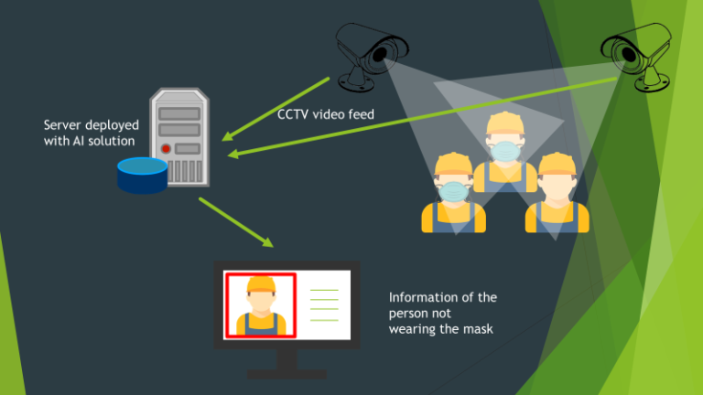
Implementation

Slide 8




Design Methodology
Deep Learning
CNN (convolutional Neural Network)

Slide 9
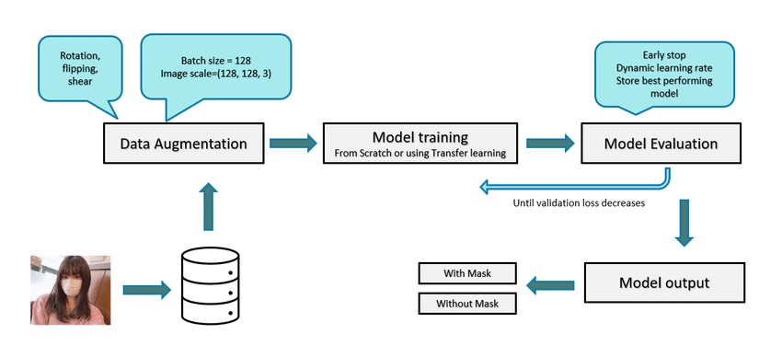
Process

Slide 10
Convolutional Neural Networks
Convolution
Activation map
Max Pooling
Fully Connected Layer

Slide 11
Methods Used
Pooling
Max Pooling
Average Pooling
Activation Function
Tanh
Relu
Soft Max

Slide 12
Social Distancing
The method which we used is by calculating the Euclidean distance to calculate distance between the people
Once the image is fully recognized and faces are detected the calculation of distance between them is done
The distance calculated is through the list of coordinates (x,y)
Giving them the threshold value of with which we can recognize whether the social distancing is being followed or not

Slide 13
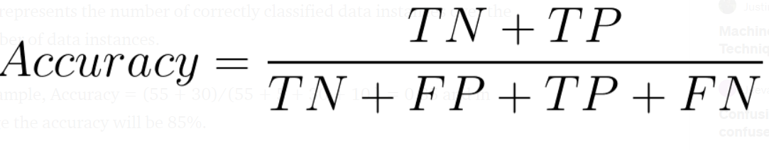
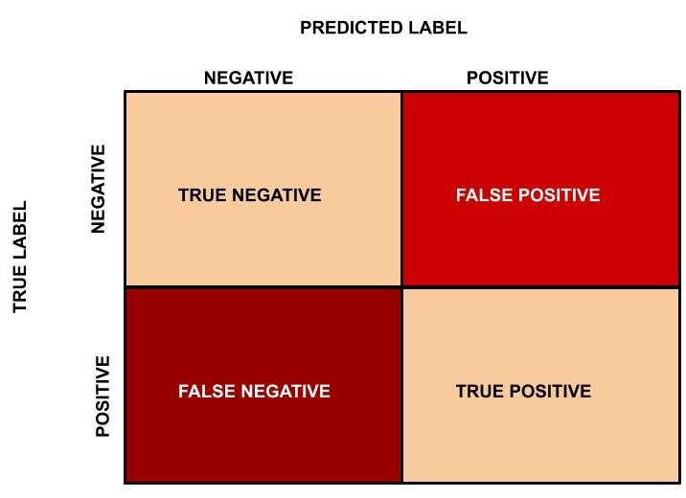
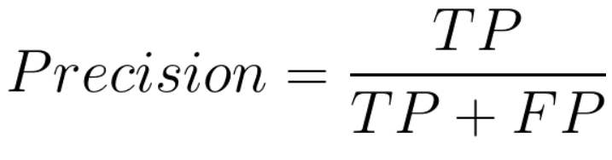
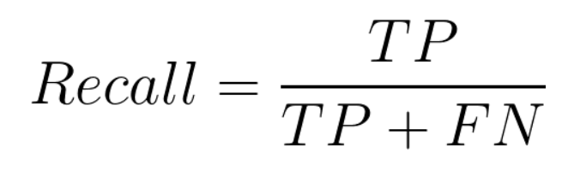
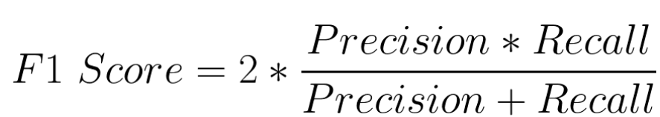
Model Evaluation based on parameters
Accuracy
Precision
Recall
F1 Score
Not masked
Classified as not masked
Not masked
Classified as masked
Not masked
Classified as not masked
masked
Classified as masked

Slide 14
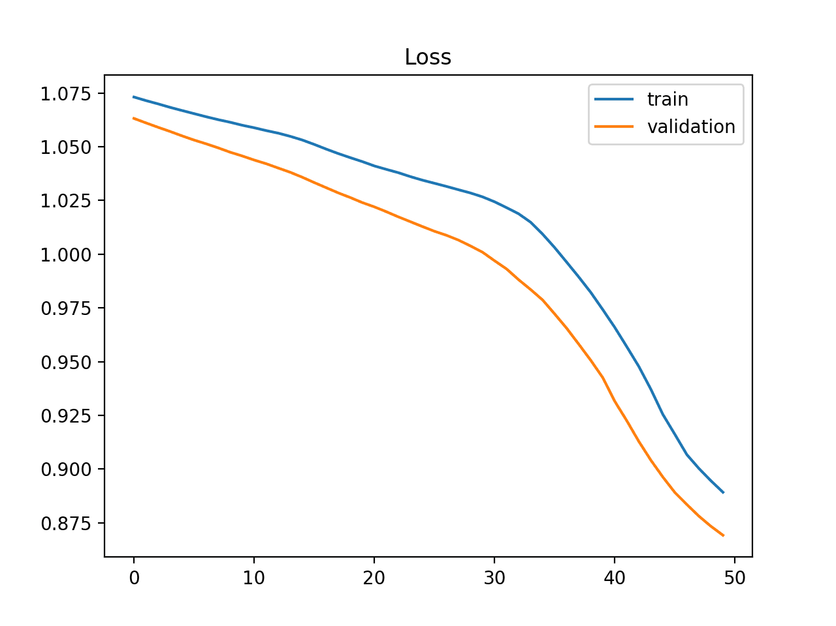
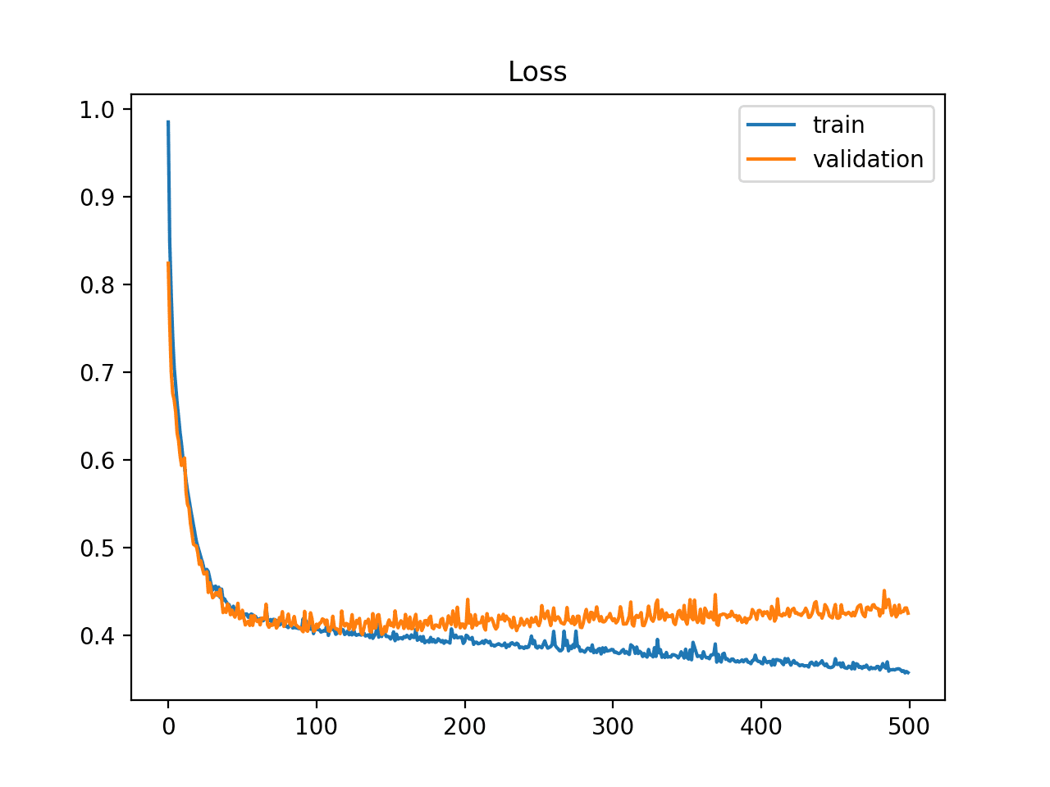
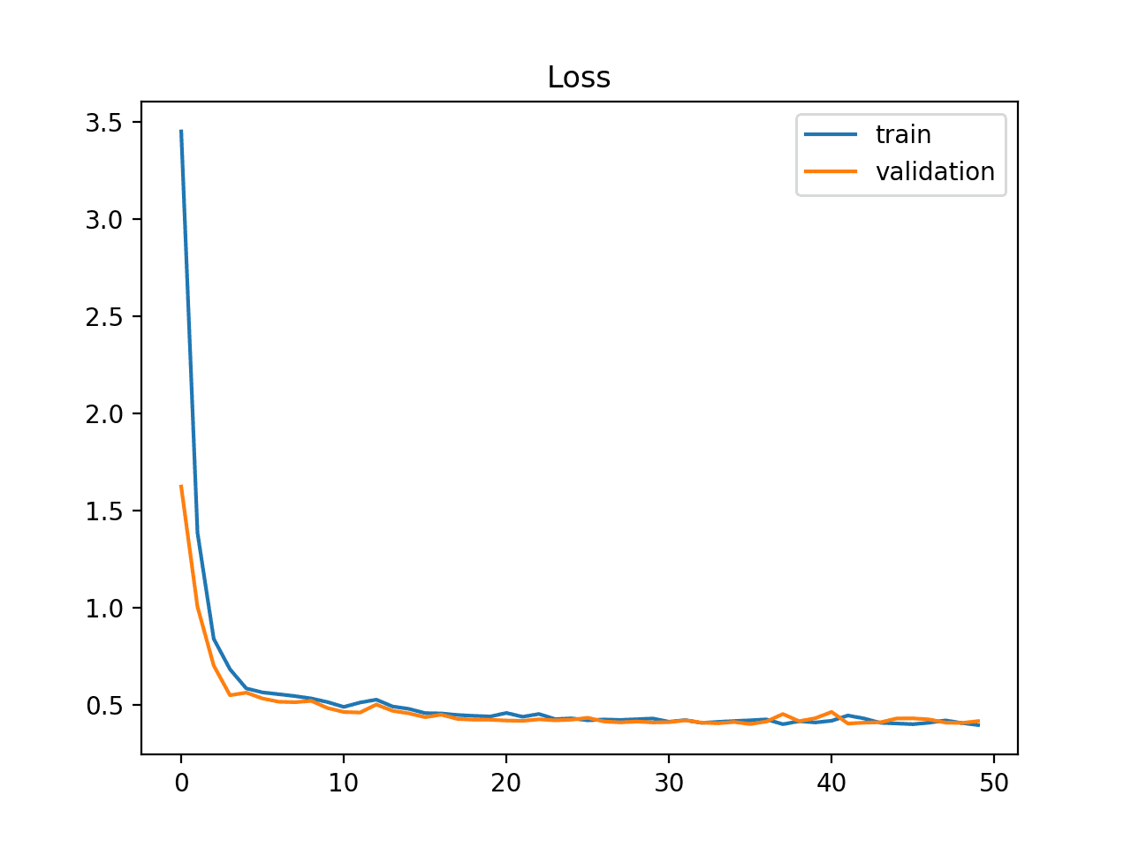
Model Evaluation based on Learning curve
Under Fitting
Over Fitting
Good Fit

Slide 15
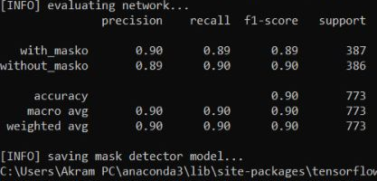
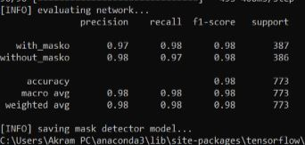
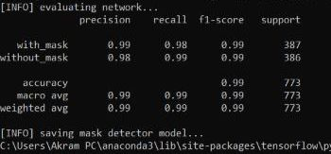
Results
Using Stochastic gradient descent
Using Max pooling, tanh and adam optimiser
Using Average pooling, Relu and adam optimiser

Slide 16
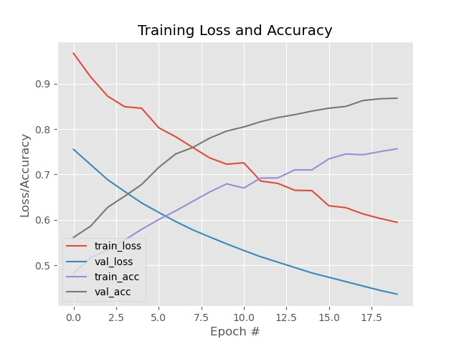
Using Stochastic gradient descent

Slide 17
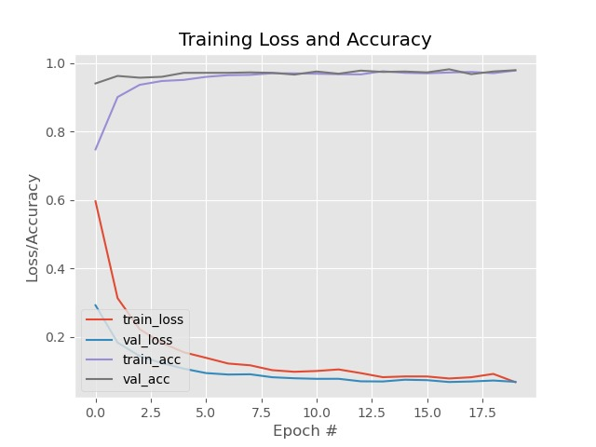
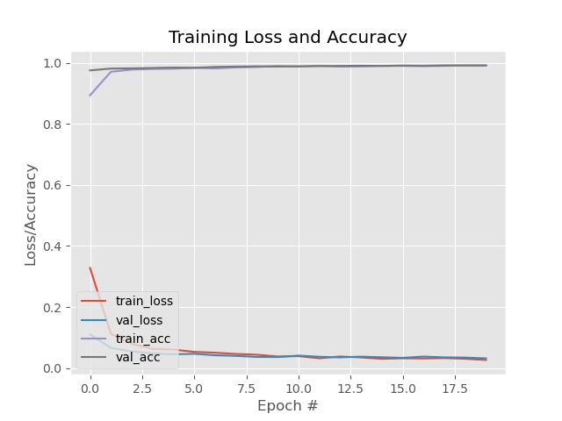
Using Max pooling, tanh and adam optimiser
Using Average pooling, Relu and adam optimiser

Slide 18
RESULTS

Slide 19
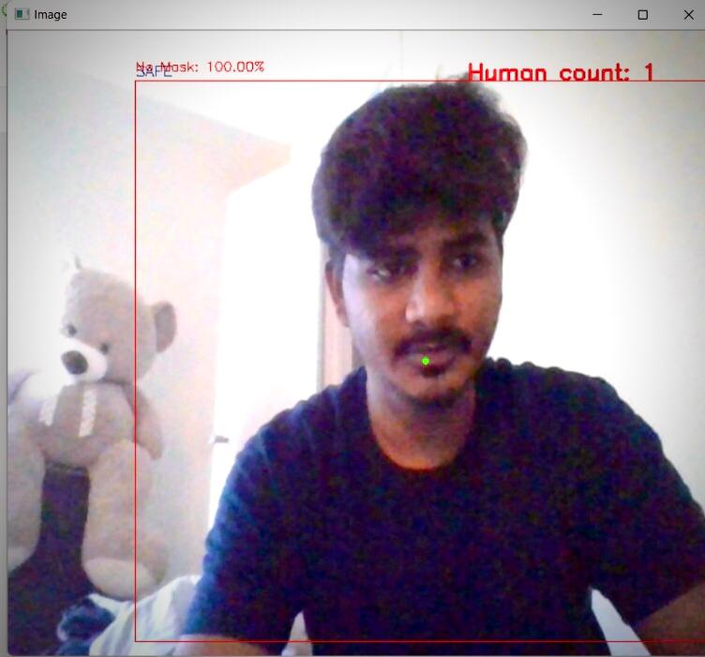
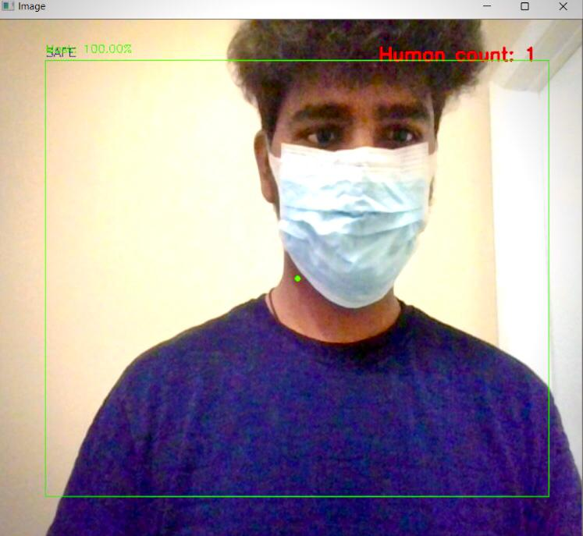
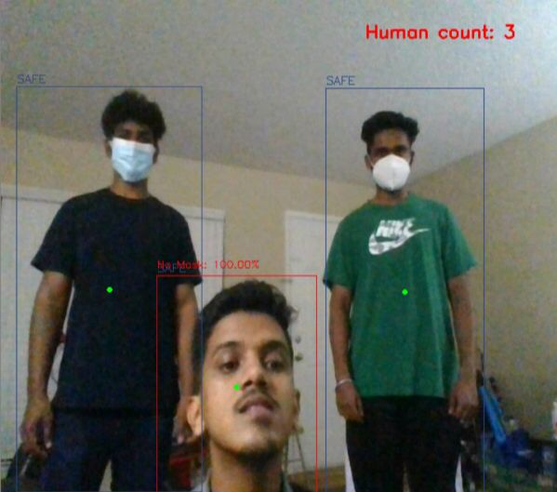
Results

